Slide 1

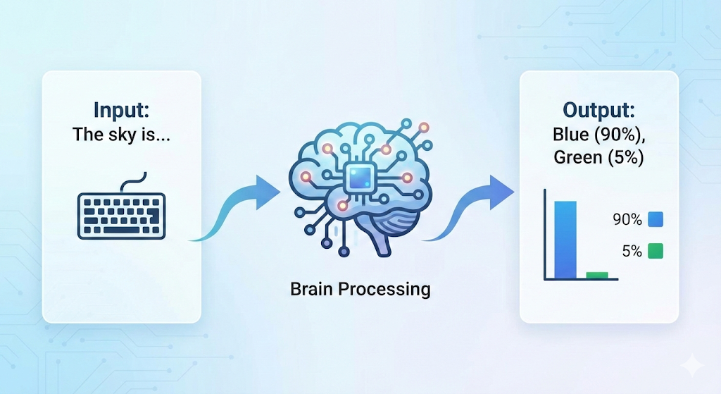
How LLMs Actually Work (The Engine)
The Core Mechanism: LLMs do not "know" facts; they predict probabilities. They are trained on massive datasets to guess the most likely next word (token) in a sequence.
The Brain (Transformer Architecture): Uses "Attention Mechanisms" to understand context. Example: In "The bank of the river," it knows "bank” ≠
"money" because it pays attention to the word "river."
Key Takeaway: It's not a database search; it's a mathematical prediction engine.

Slide 2

Basic Working of Large Language Models
Step-by-Step Working
1️⃣ Input (Prompt): User gives instruction.
Example: “Create a motivational fitness caption for college students.”
2️⃣ Understanding Context: LLM identifies:
Topic → Fitness
Audience → College Students
Tone → Motivational
3️⃣ Token Prediction: LLM predicts the next most meaningful word based on patterns learned during training.
4️⃣ Output Generation: Produces complete human-like text response.
Key Point: LLM does not “search answers” — it predicts language patterns to generate responses.

Slide 3


The "Generative" Power
STATIC
GENERATIVE
Goal: Classify or Discriminate.
Retrieve: Finds existing data.
Example: "Is this email Spam or Not Spam?"
Limitation: Can only show you what already exists. If a personalized summary doesn't exist, it can't show it.
Goal: Create and Generate.
Create: Synthesizes new data from scratch.
Example: "Write a reply to this email."
Capability: Can combine concepts, rewrite tones, and generate unique content for every single user.
Why It Matters: This allows for "Zero-Shot" creation—doing tasks it was never specifically programmed to do.

Slide 4

Role of LLM in Our Project
LLM as the Core Engine of Personalized Media System
In Our Project, LLM Will:
Understand user preferences
Generate personalized content
Adjust tone and style
Create platform-specific content
Summarize or rewrite content
Simple Flow: User Input → Prompt → LLM → Personalized Output.

